Slide 1
Varve Analysis
Presented By Arijit Dutta

Slide 2
Introduction :
A varve is an annual layer of sediment and sedimentary rock. Varve analysis is aslo known as varve chronology and varve count. The annual layers of sediments that deposited on the floor of the glacial lake or other relatively quiet water bodies. The word varve desires from the Swedish word varv whose meanings and connotation include revolution and layers and circle. The term first appeared as Hvarfig lera on the first map produced by Geological Survey Of Sweden in 1862. Where varve refered to each of the seperate components comprising a single annual layer in glacial lake sediments.
In 1910 the Swedish geologist Sir Gerard De Geer proposed a new fformal definition, where varve means the whole of any sedimentary rock.
Basically varve layers made by two seasons. 1.Melting season or Summer layers(thicker and lighter) and 2.Non-melting season or Winter season(thinner and darker). So it means 1summer+1winter = 1year. By counting varves it is possible to establish an absolute time scale of the fossils, up to about 20,000 year’s ago. 1summer+1winter = 1 year.

Slide 3
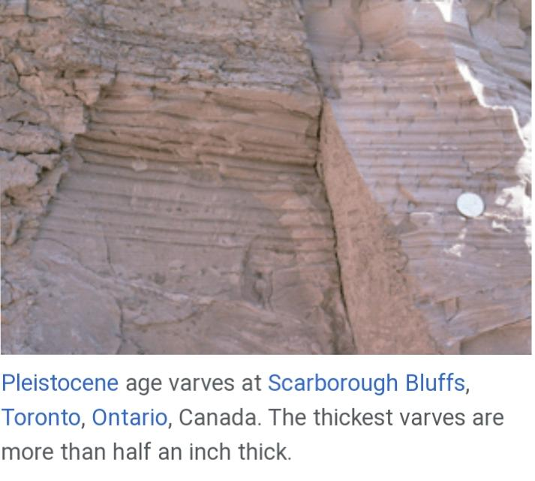
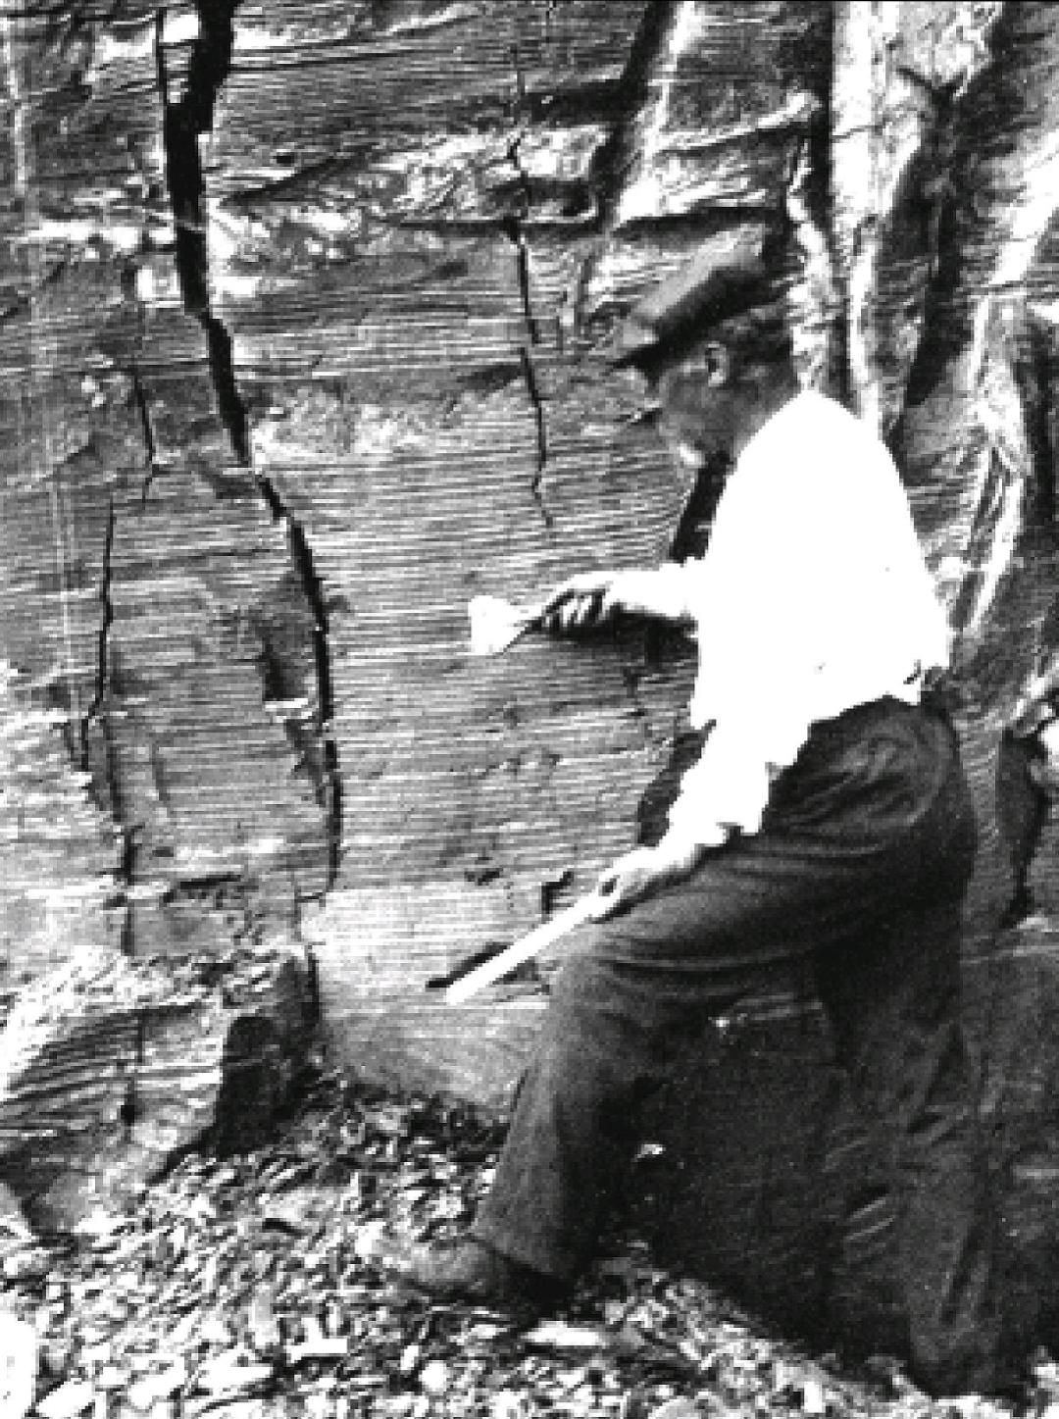
Basic Principles :
Varve analysis involves studying annual layers of sediment in bodies of water, typically lake. Here are some basic principles :
Formation of Varves.
Annual Nature.
Depositional Environment.
Climate Records.
Dating and Chronology.
Microscopic Analysis.
Interpreting Events.

Slide 4
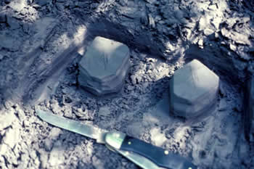
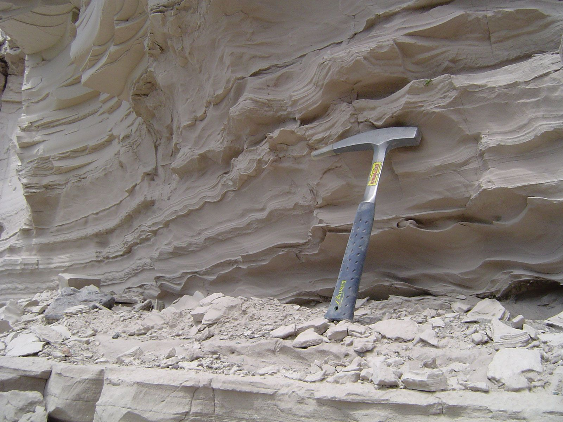
Method Of Sample Collection :
In varve analysis, method of sample collection is crucial for preserving the sediment fabric and recovering the sediment-water face, which provides the baseline for further analysis. There are several techniques for collecting samples :
Coring.
Crust-freeze Sampler.
Non-Destructive Techniques.
When collecting samples,it is essential to ensure that technique does not disturb the magnetic signals during coring. Clusters of samples should be taken about every 50 years to record secular variations in the sediment.

Slide 5
Laboratory Procedure :
Varve analysis involves examining annual sediment layers in bodies of water to study past environmental changes. The laboratory procedure for varve analysis involves several steps –
Sample Collection(sample preparing,sample mounting).
Core Collection(core preparing,core sampling).
Dating Techniques(radio carbon dating and others).
Measurements.
Microscopic Examination.
Interpretation.
Statistical Analysis/Data Analysis.
Documentation.

Slide 6
Source Of Error Calibration :
Sources of error in varve analysis calibration can include variations in sediment deposition rates, changes in sediment composition, taphonomic processes altering the varve record, and inaccuracies in dating methods such as radiocarbon dating. Additionally, environmental factors like climate fluctuations may impact varve formation, contributing to calibration uncertainties. It’s crucial to consider these potential sources of error when interpreting varve records for accurate paleoenvironmental reconstructions.

Slide 7
Benefits and Drawbacksof this Dating :
Benefits :
Drawbacks :
Chronological Dating.
Climate Reconstruction
Envioronmental Monitoring.
Paleoclimate Studies.
Religional Limitations.
Depositional Variability.
Biological Influence.
Dating Precision.

Slide 8
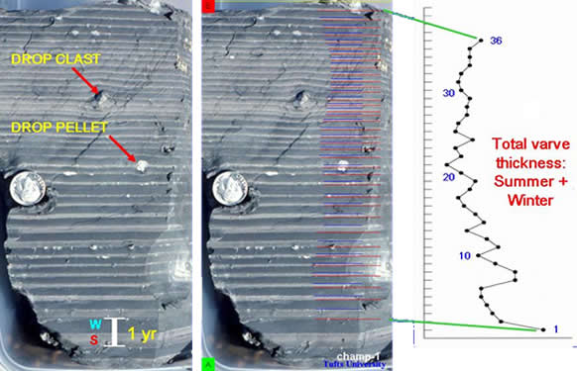
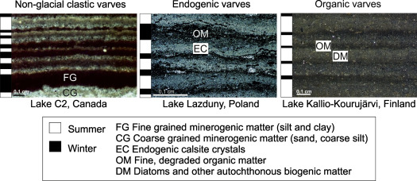
Example of Significant Application :
Varve analysis is the study of annual layers of sedimentary rock or sediment. An example of varve analysis can be found in the Santa Barbara basin off California,where well-known marine varved sediments are located. Another example is the palaeo-lacustrine record of the Piànico–Sèllere Basin in the southern Alps.Varve analysis involves counting and measuring the thicknesses of annual paired layers of lake sediments deposited in lakes that undergo an annual freeze-up.These sediments are valuable for understanding changes in climate and environmental systems at an annual or even seasonal resolution.

Slide 9
References :
Quaternary Dating Methods Book by M. J. C Walker and Mike Walker.
Enyclopedia-Britanica. (Varve analysis)
Science Direct. (Varve an overview)
Other Internet Sources.

